Slide 1
GLOBAL TEMPERATURE CHANGE GRAPHS a primer for energy and climate connections unit in GEOG 106
For more detail, see the following data, mostly from NASA
http://www.climate.gov/#climateWatch

Slide 2
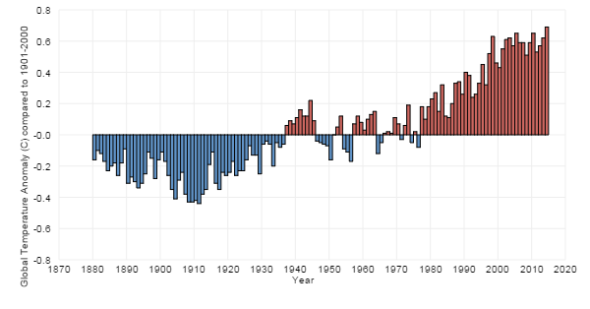
Global temperature changes, 1880 – 2014

Slide 3
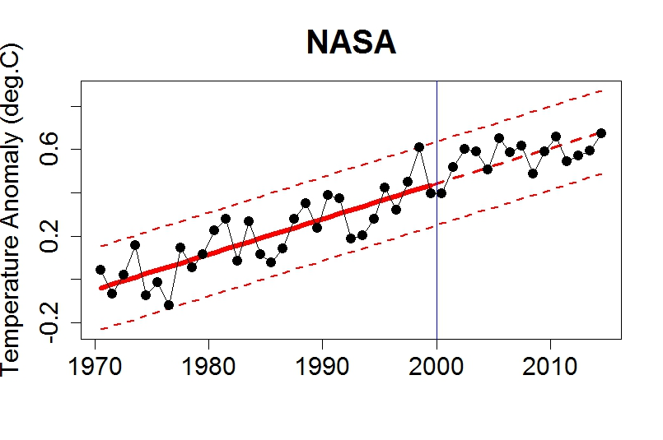

Slide 4
Global Temperature Animation
https://youtu.be/uVmpDk4rEI0

